Slide 1
CA2 TIME SERIES
Haaris Sulaiman P2112815

Slide 2
PREDICTION TASK

Slide 3
What is the task?
Using air-pollution dataset to train a time series model for future air pollution forecasting.

Slide 4
DATA EXPLORATION & CLEANING

Slide 5
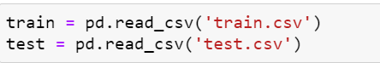
Train Dataset
Test Dataset

Slide 7
TRAIN DATASET

Slide 8
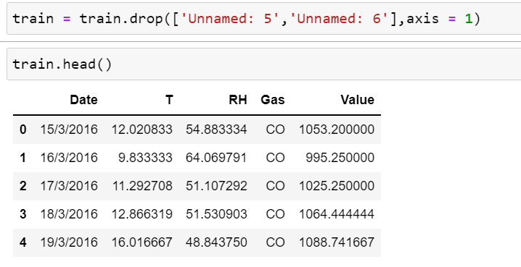
I had to drop 2 unnecessary columns

Slide 9
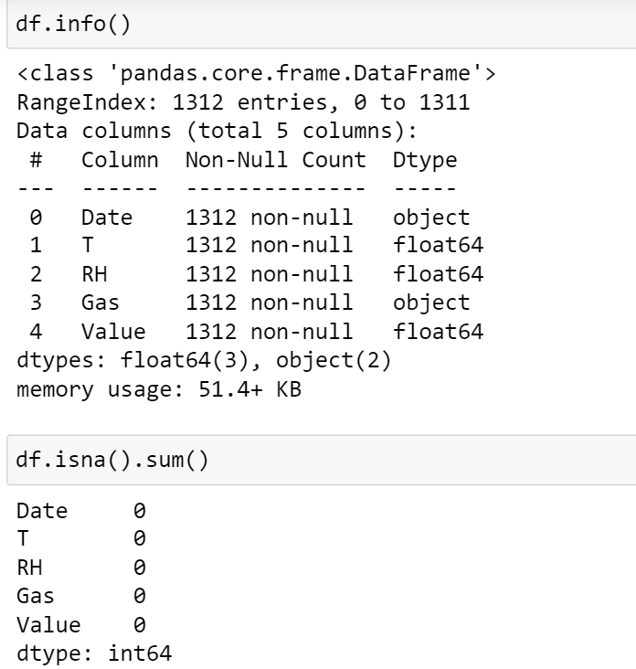
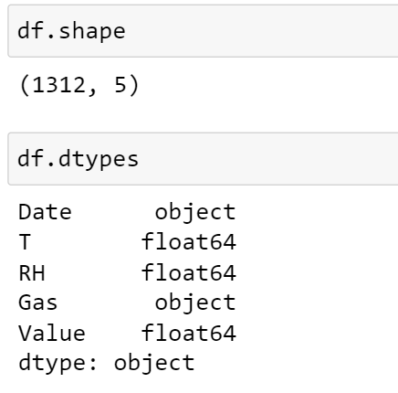
There are 1312 rows and 5 columns of data. There are no null rows and this we have no missing data to drop or impute.

Slide 10
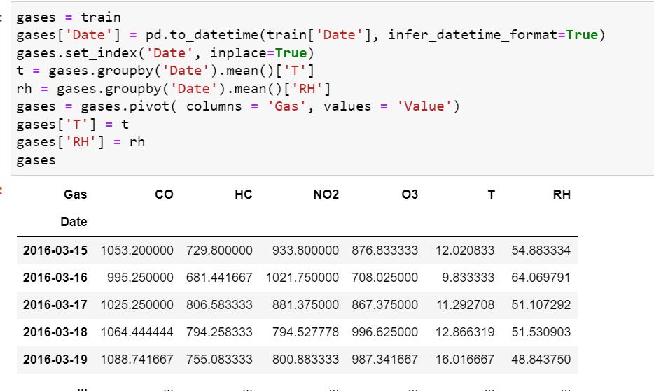
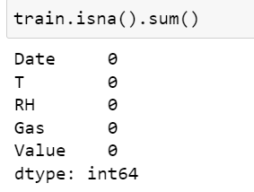
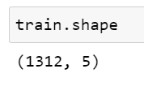

Slide 11
TEST DATASET

Slide 12
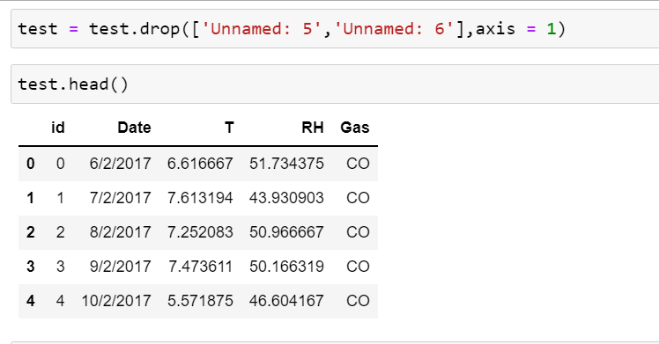
I have to drop 2 unnecessary columns for the test dataset as well

Slide 13
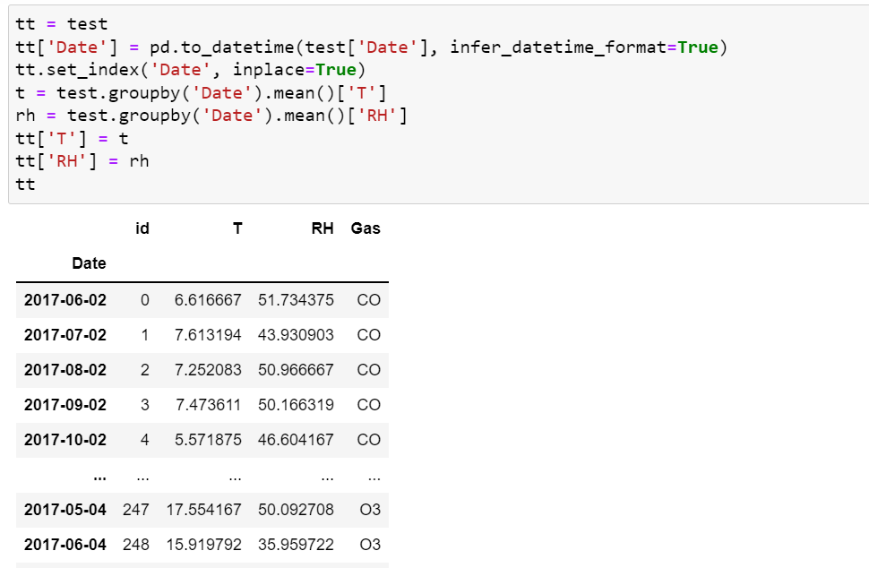
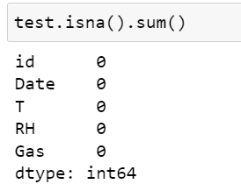
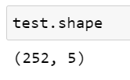

Slide 14
INTERPOLATION

Slide 15
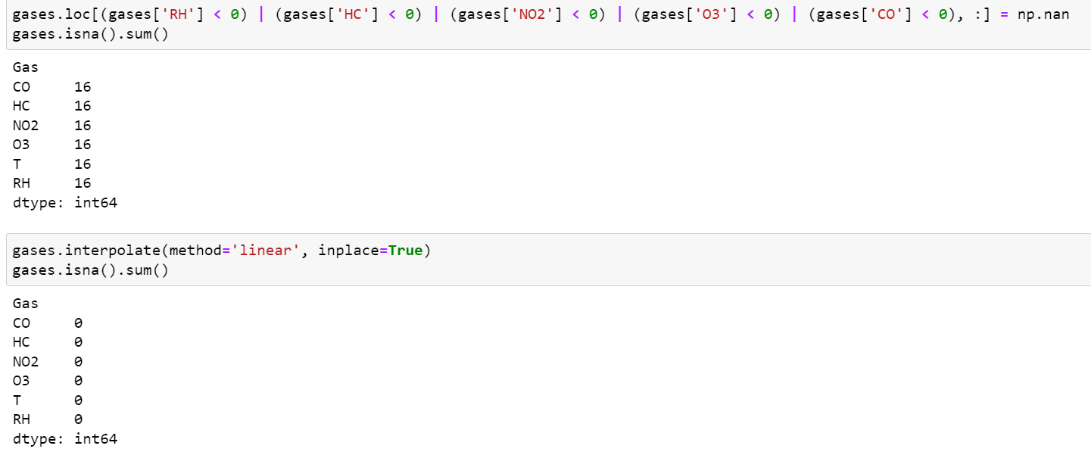

Slide 16
EXPLORY DATA ANALYSIS

Slide 17
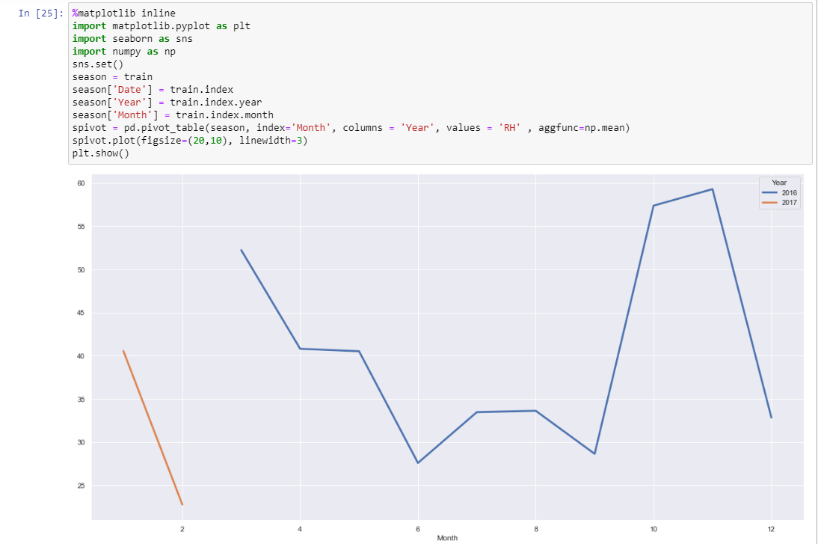
Relative Humidity

Slide 18
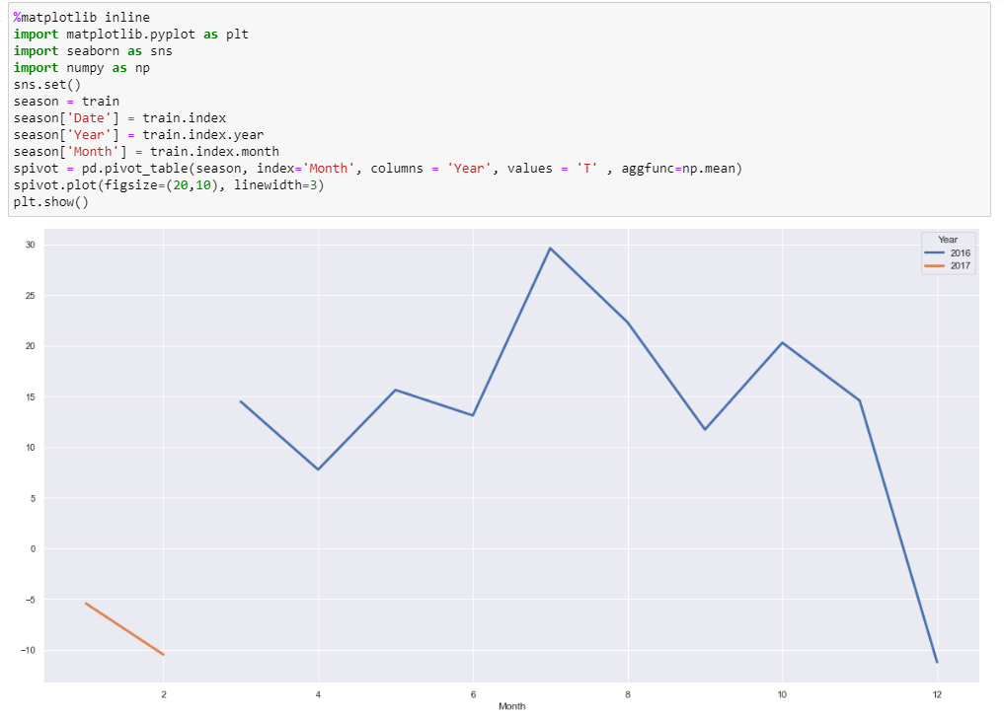
Temperature

Slide 19
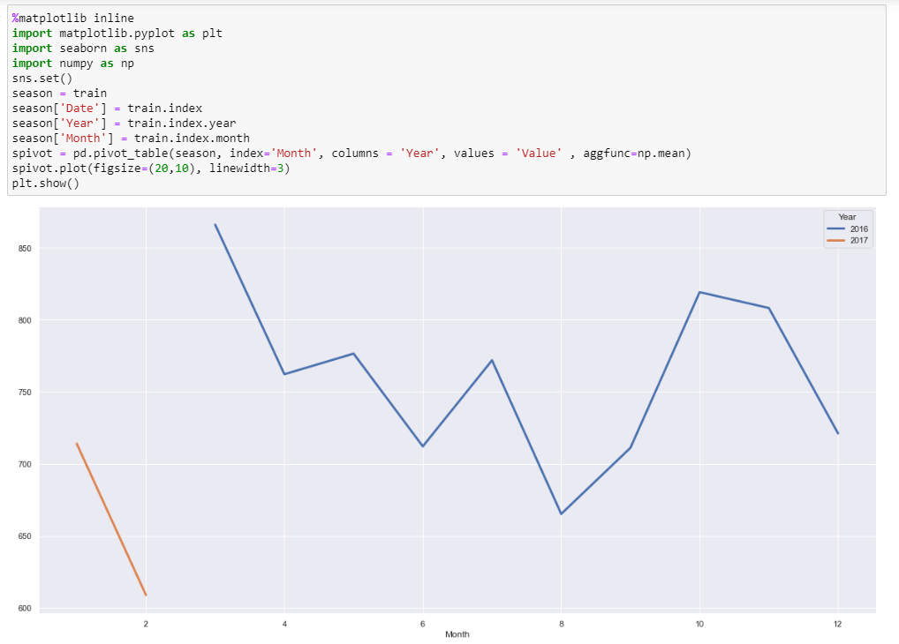
Pollution Value

Slide 20
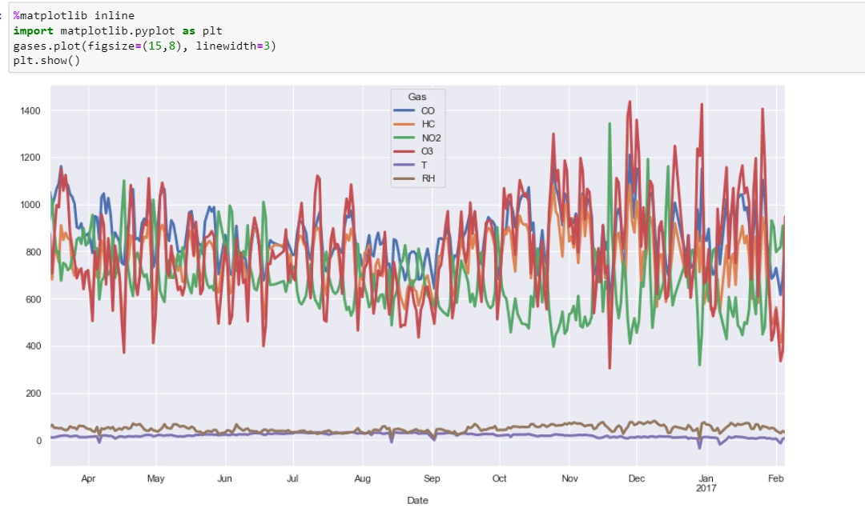
Gases

Slide 21
STATIONARITY

Slide 22
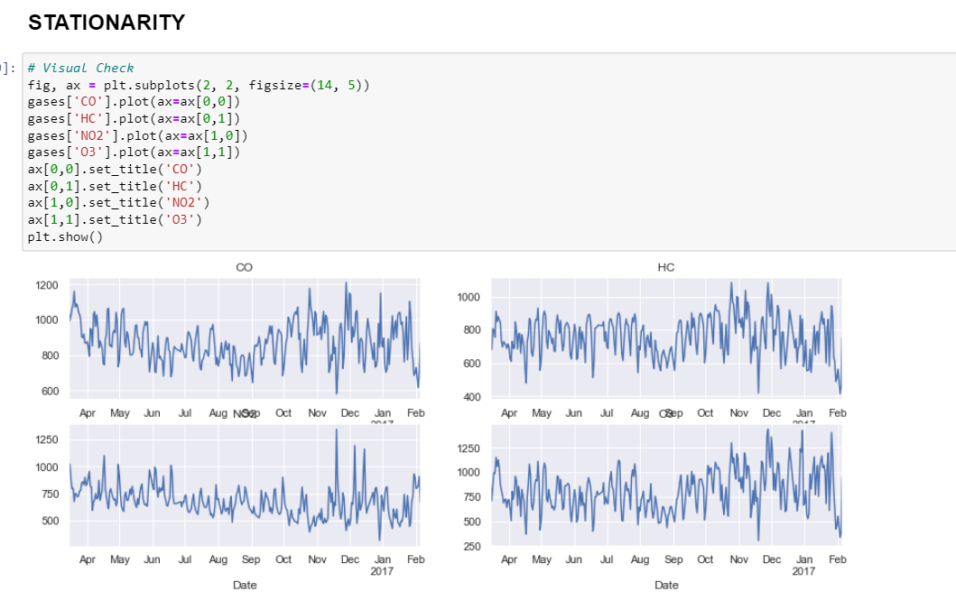

Slide 23
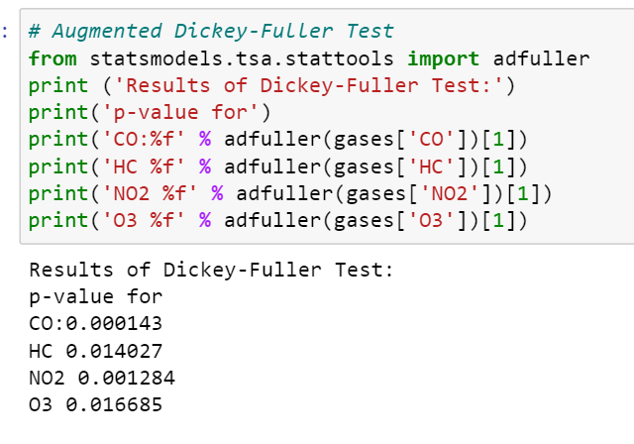
Since the p-value for each of the gases is smaller than 0.05, we reject the null hypothesis. The time series is stationary

Slide 24
SEASONAL DECOMPOSITION

Slide 25
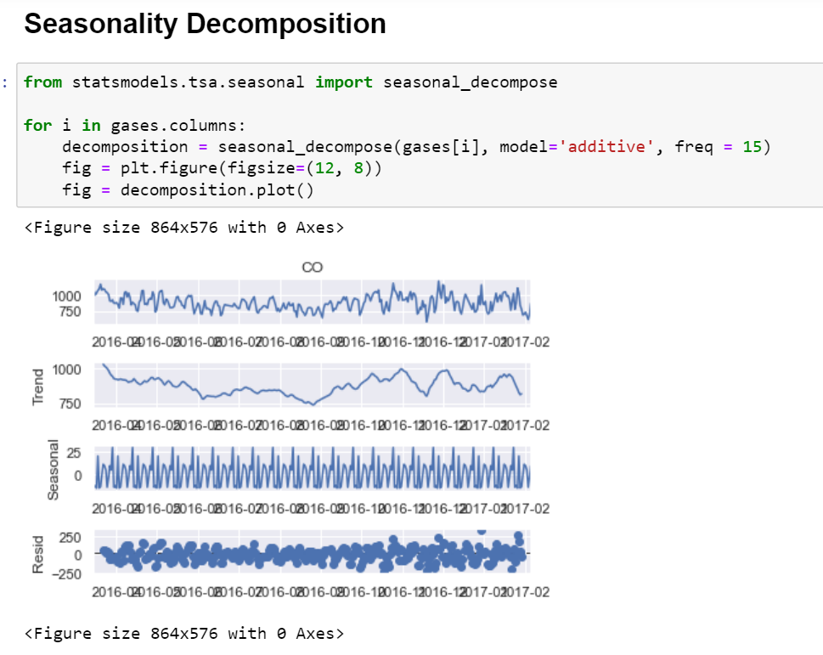
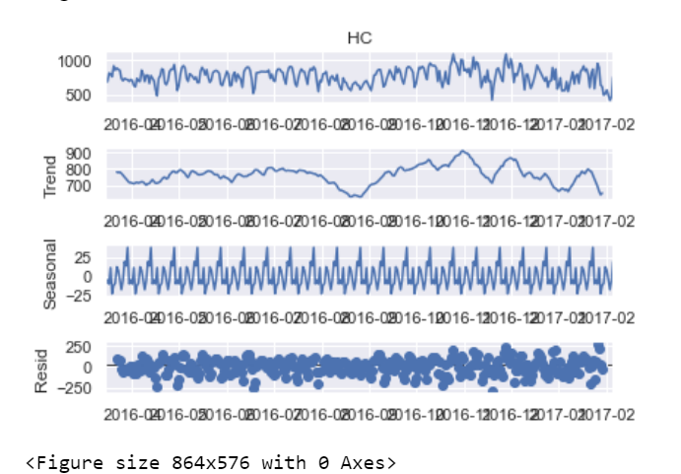
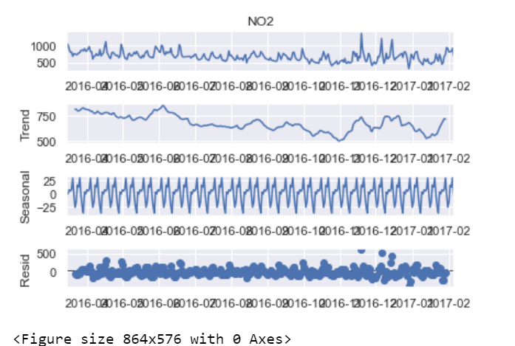

Slide 26
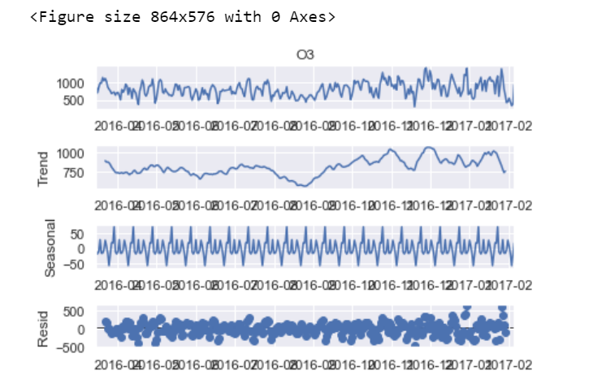
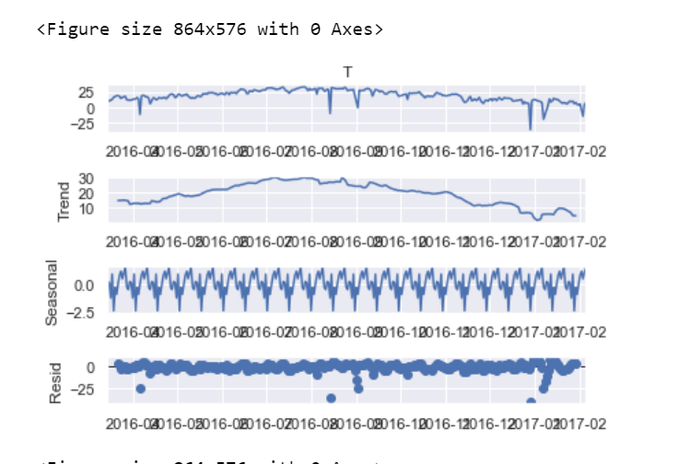
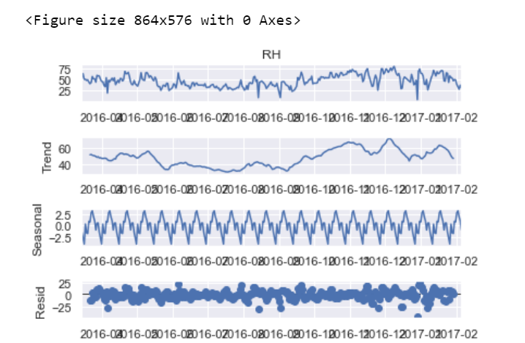

Slide 27
MODEL SELECTION

Slide 28
Simple Moving Average
Holt-Winters Simple Exponential Smoothing
SARIMAX

Slide 29
SIMPLE MOVING AVERAGE

Slide 30
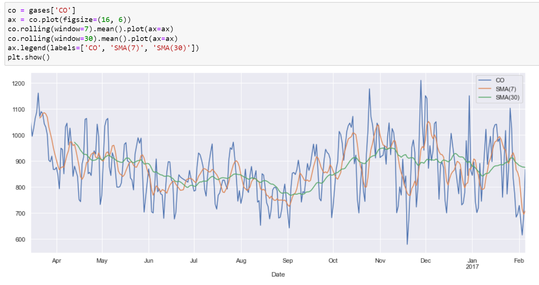
CO

Slide 31
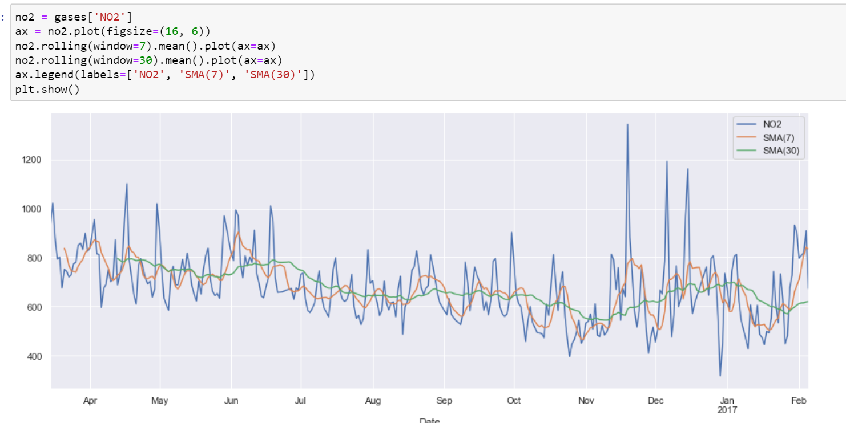
NO2

Slide 32
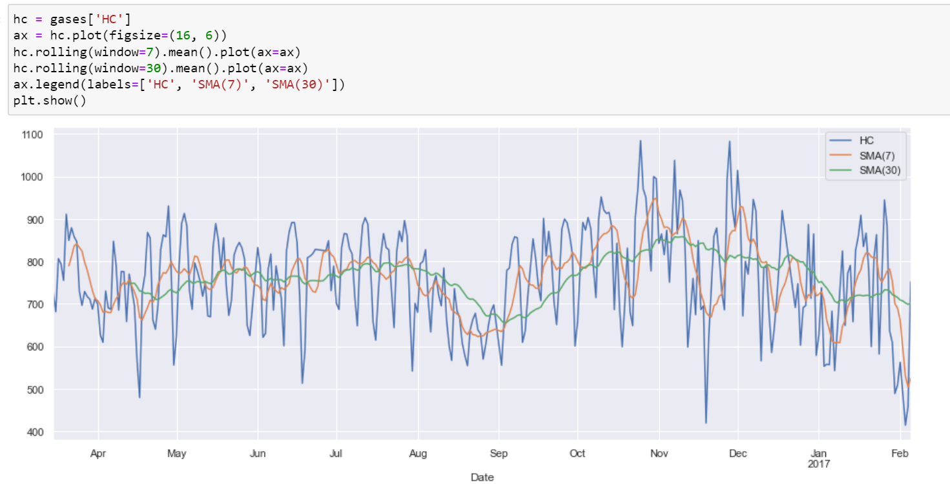
HC

Slide 33
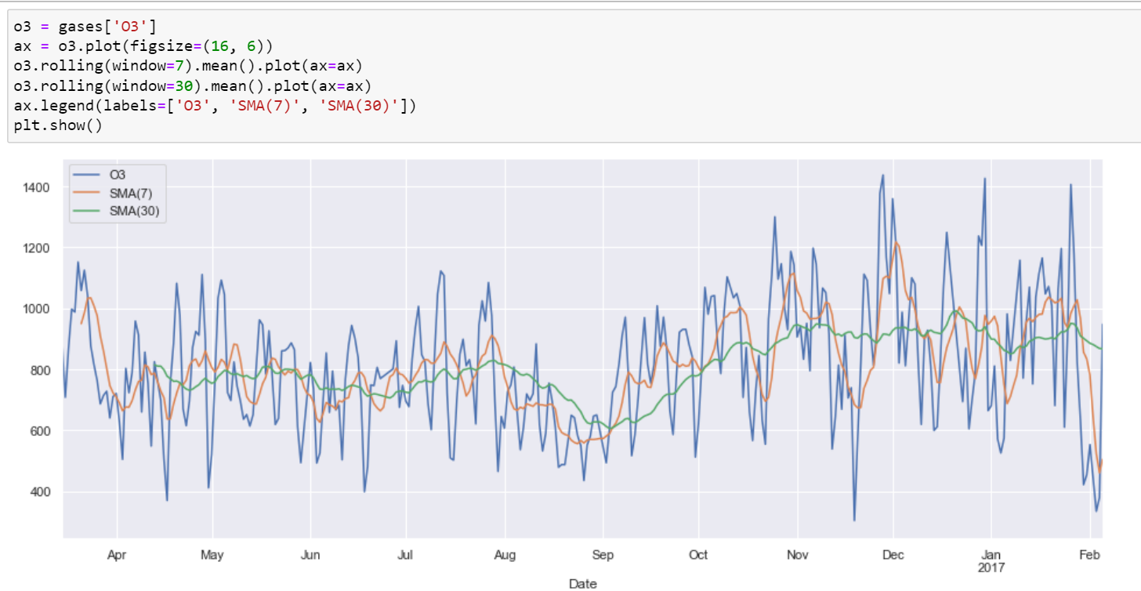
O3

Slide 34
HOLT-WINTERS

Slide 35
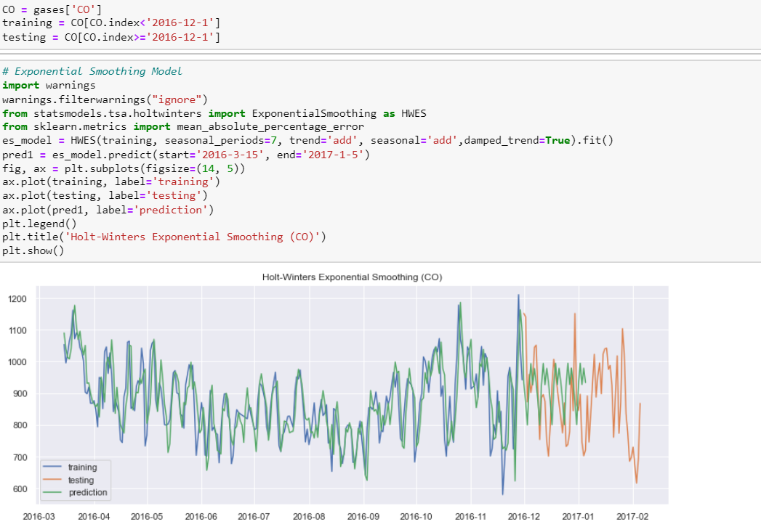
CO

Slide 36
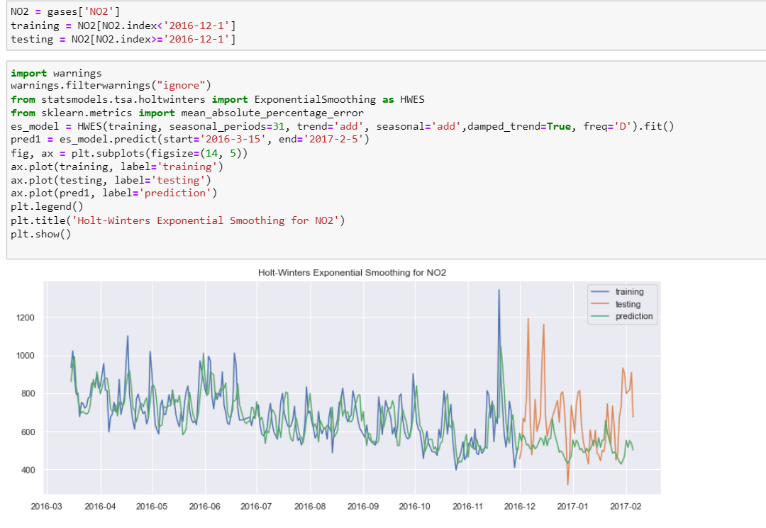
NO2

Slide 37
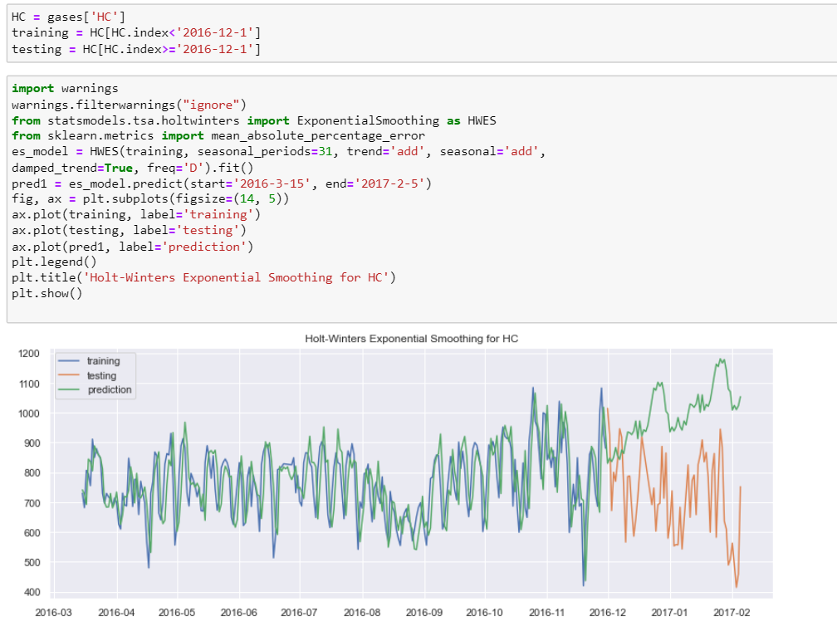
HC

Slide 38
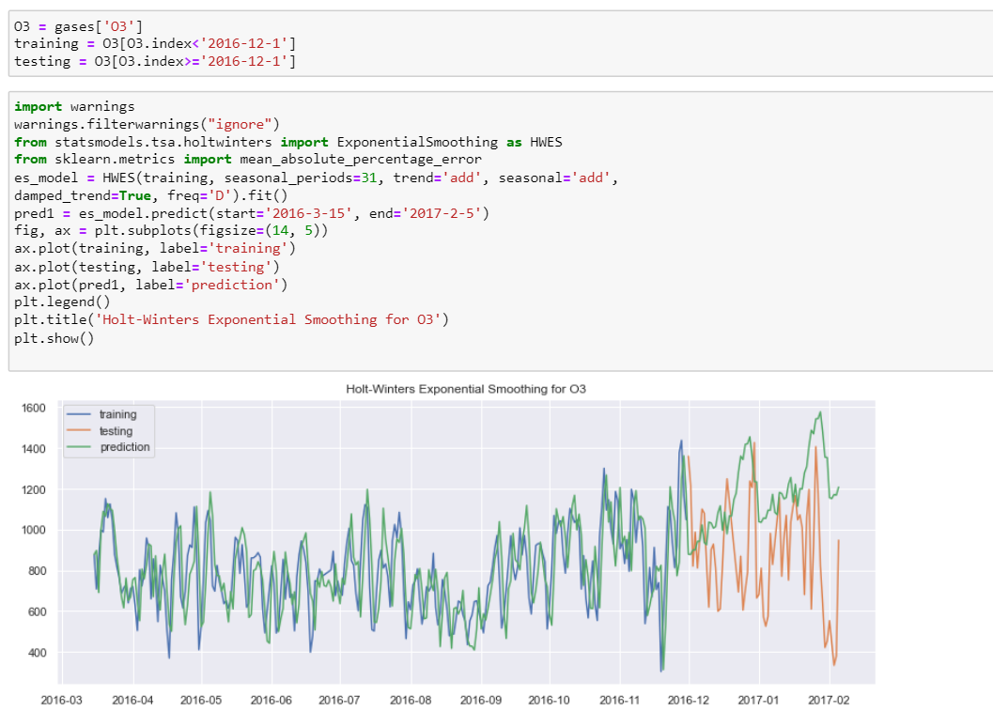
O3

Slide 39
SARIMAX

Slide 40
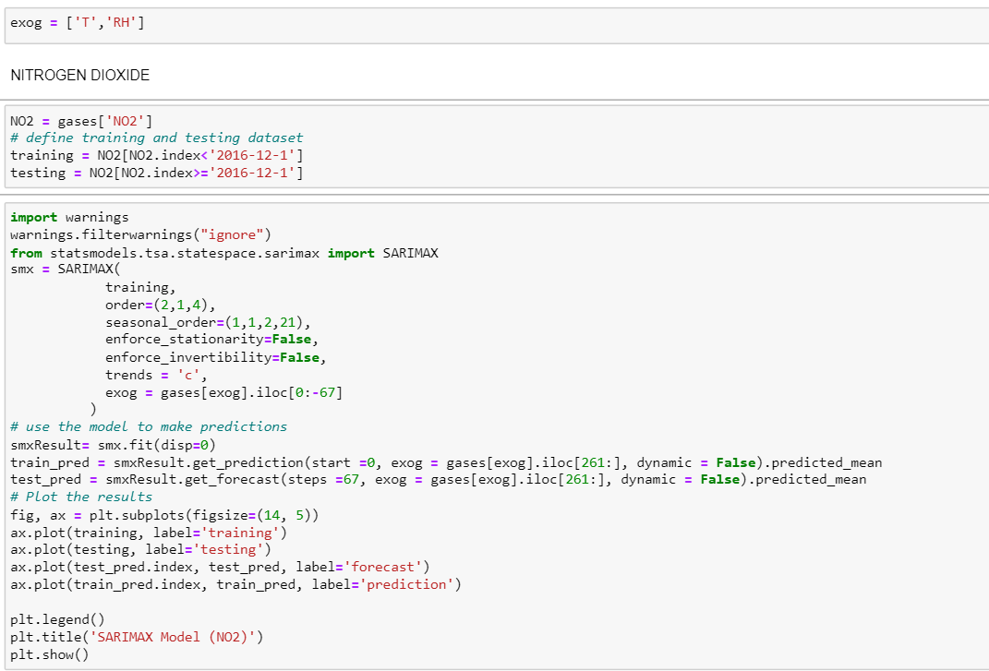
NO2

Slide 41
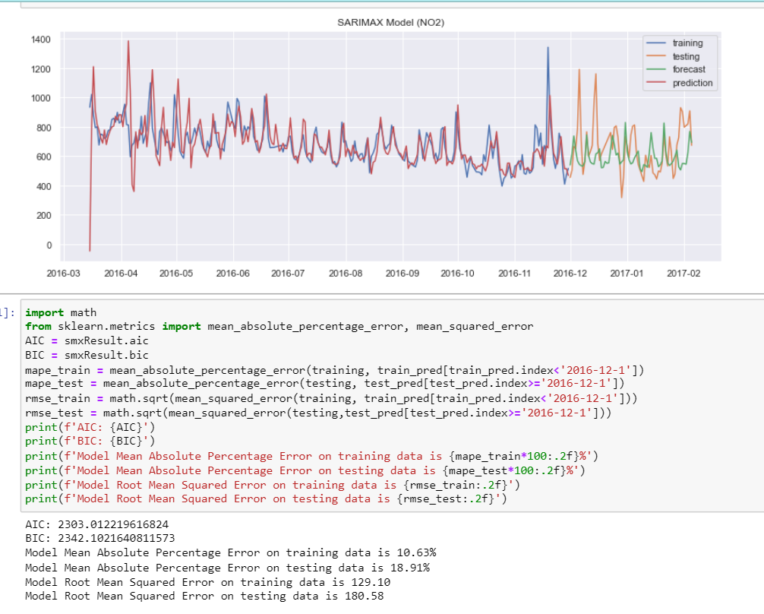
NO2

Slide 42
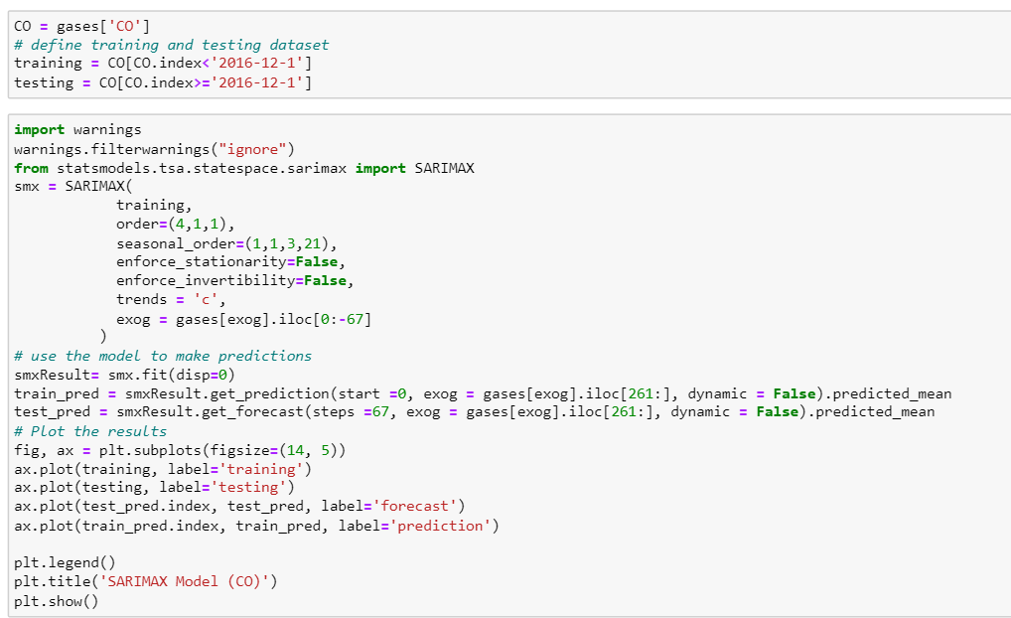
CO

Slide 43
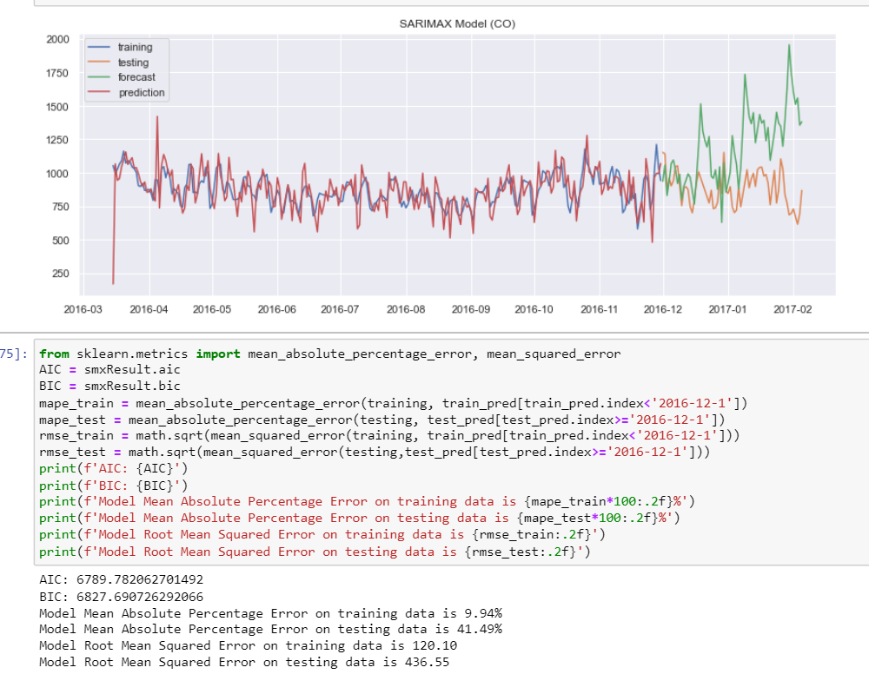
CO

Slide 44
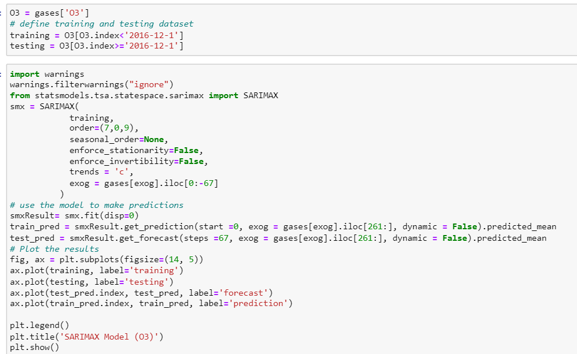
O3

Slide 45
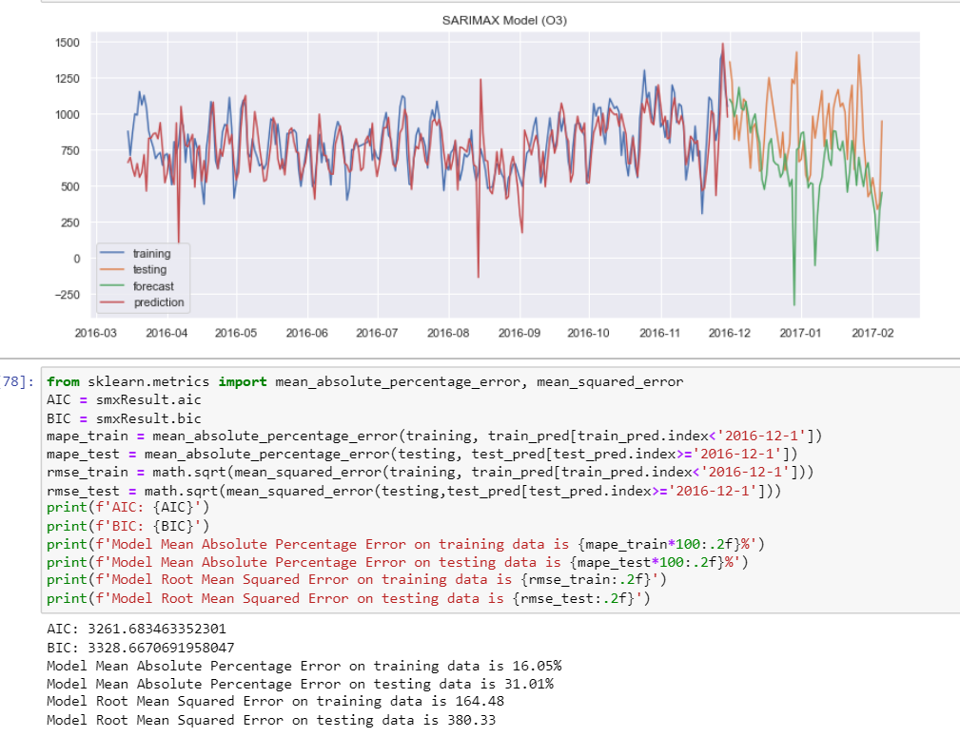
O3

Slide 46
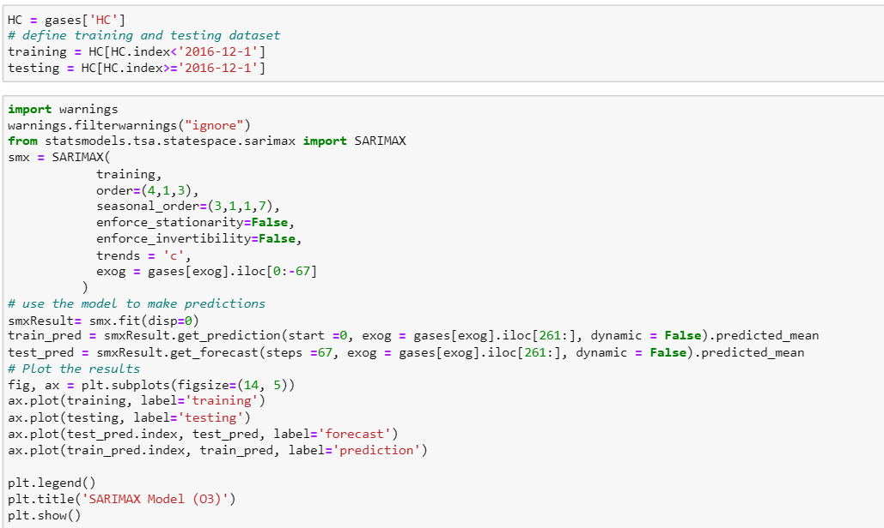
HC

Slide 47
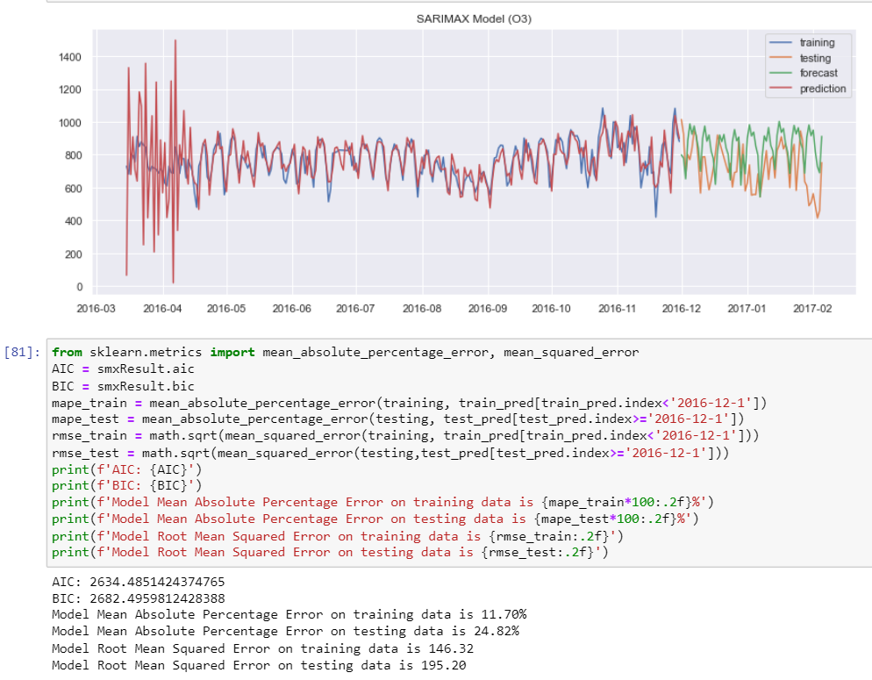
HC

Slide 48
Model Chosen
I will be using the SARIMAX model because it is a model that is more suited for this time series and the MAPE values are very good for each of the gases. Using SARIMAX can help predict the pollution values for 63 days

Slide 49
FORECASTING

Slide 50
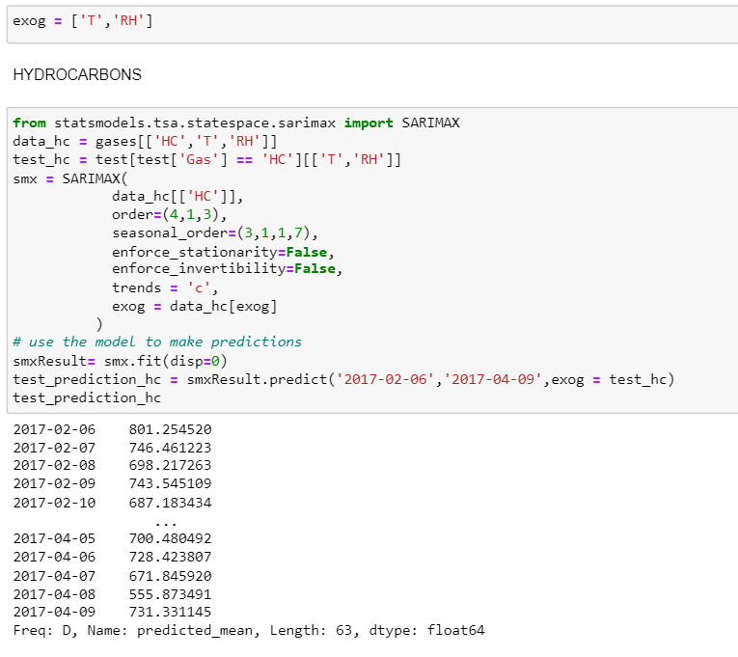
HC

Slide 51
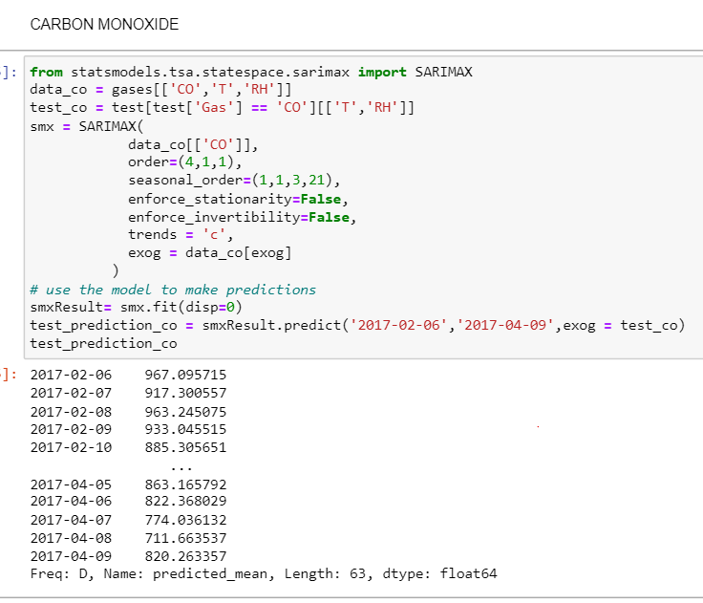
CO

Slide 52
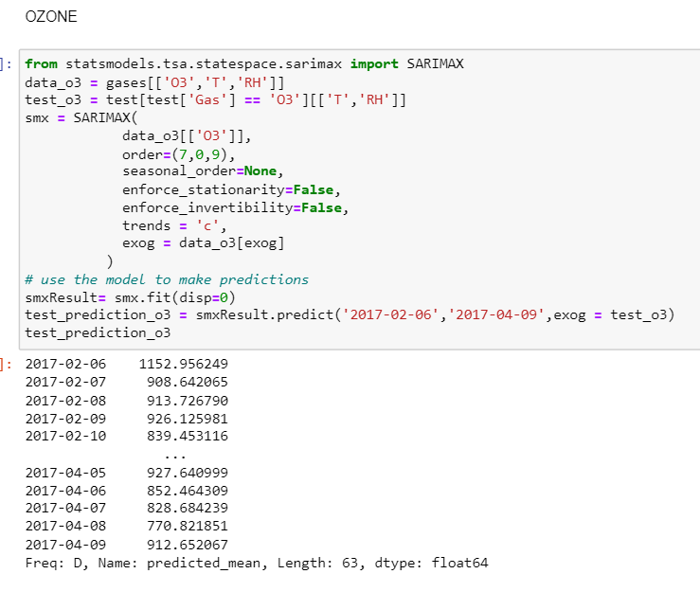
O3

Slide 53
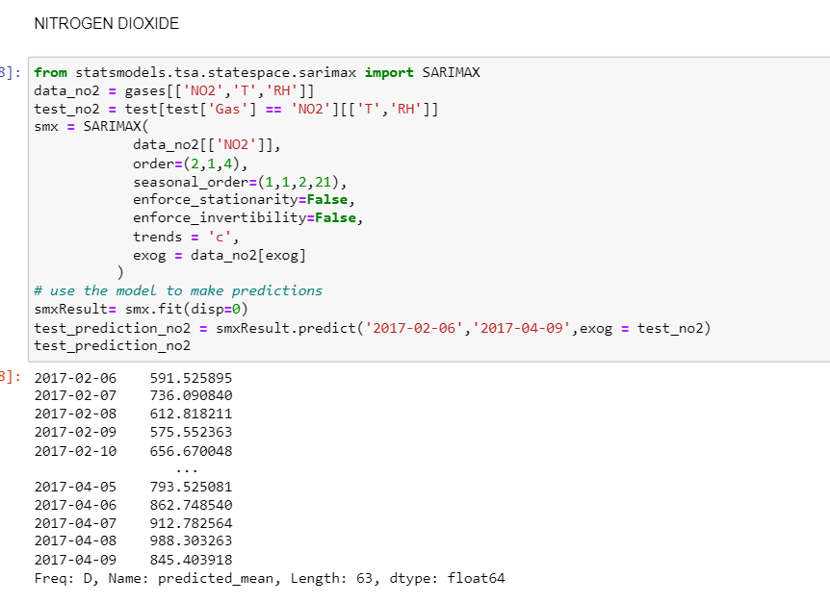
NO2

Slide 54
KAGGLE SUBMISSION

Slide 55
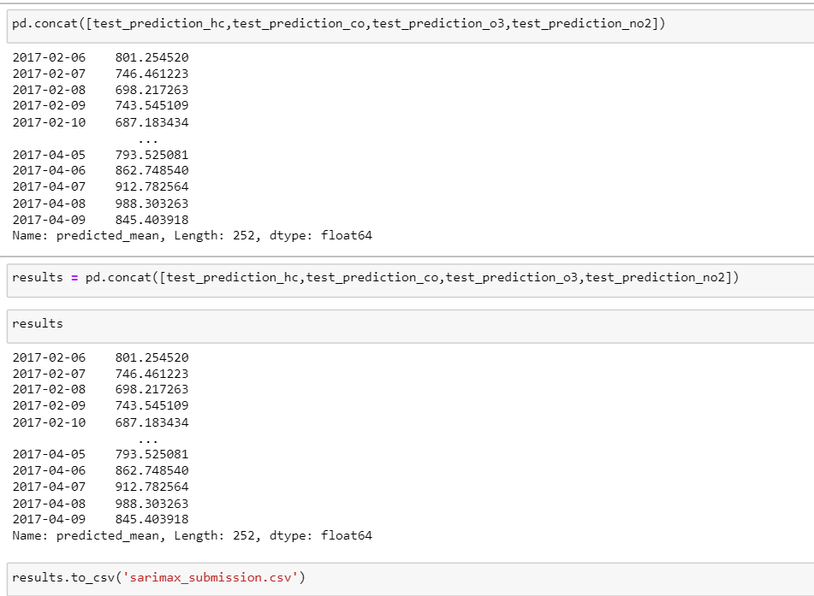
NO2

Slide 56
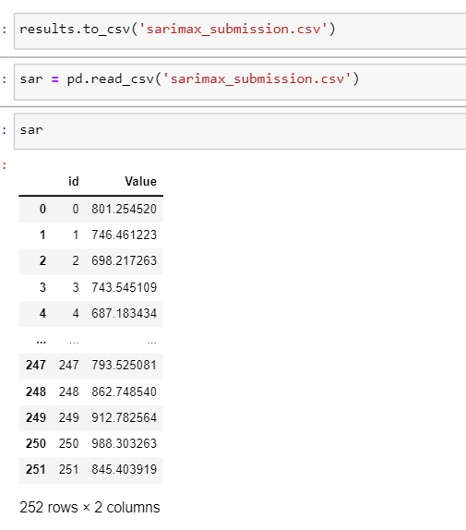

Slide 57
THANK YOU

